Slide 1
Oracle certified Java associate
Lesson 19
Andrei Dragutan

Slide 2
2 parts
Exceptions
Practice

Slide 3
Objectives:
What is an exception?
Categories of exceptions
Creating a method that throws an exception
Common exception classes

Slide 4

What is an exception?
An exception (or exceptional event) is a problem that arises during the execution of a program.

Slide 5
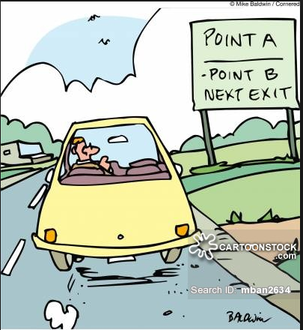
Exception: real life similarities
Car can break
You can run out of gas
You can get sick

Slide 6
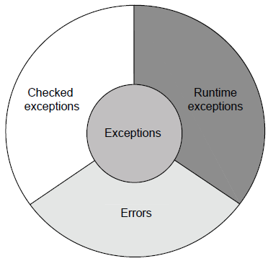
Exceptions: categories
Checked exceptions
Runtime exceptions (unchecked)
Errors

Slide 7
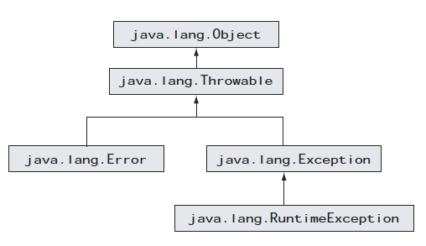
Exceptions: hierarchy
Checked exceptions extend java.lang.Exception Runtime exceptions extend java.lang.Exception

Slide 8
Exceptions: checked
Definition: checked exception is an unacceptable condition, foreseen by the author of the method but outside his/her immediate control.
Checked exceptions are checked during the compile time. If a method call throws an exception, the compiler checks if it’s handled or if it’s thrown further Example: FileNotFoundException

Slide 9
Exceptions: runtime
Definition: representation of a programming error. These occur due to inappropriate use of the code.
They are called runtime exceptions because it is not possible for the compiler to determine if this code will fail or not at compile time. Example: NullPointerException - access methods or attributes of not initialized object, ArrayIndexOutOfBoundsException

Slide 10
Exceptions: errors
Definition: error that is thrown by the JVM, as a result of an error in the environmental state that processes your code. Example: StackOverflowError - the code uses more memory than it has allocated
NoClassDefFoundError - cannot find the class that it should run.

Slide 11
Exceptions: what happens when an exception is thrown
When an error happens, JVM creates an Object of type Throwable (all the exceptions are of type Throwable), fills it in with information:
what happened? where? then looks for the appropriate piece of code to handle this error.

Slide 12
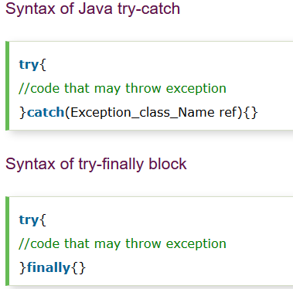
Java try block
Java try block is used to enclose the code that might throw an exception. It must be used within the method.
Java try block must be followed by either catch or finally block.

Slide 13
Exceptions: try-catch-finally
Try to execute the code
Catch the exceptional event by performing additional logic
Finally, execute a block of code, regardless, was the exception thrown or not.

Slide 14
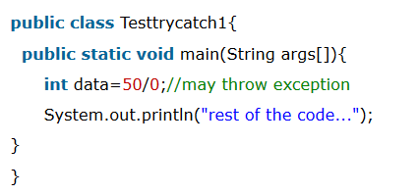
Problem without exception handling

Slide 15
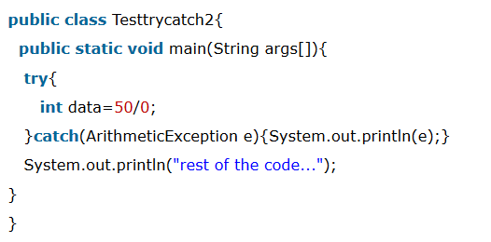
Solution by exception handling

Slide 16
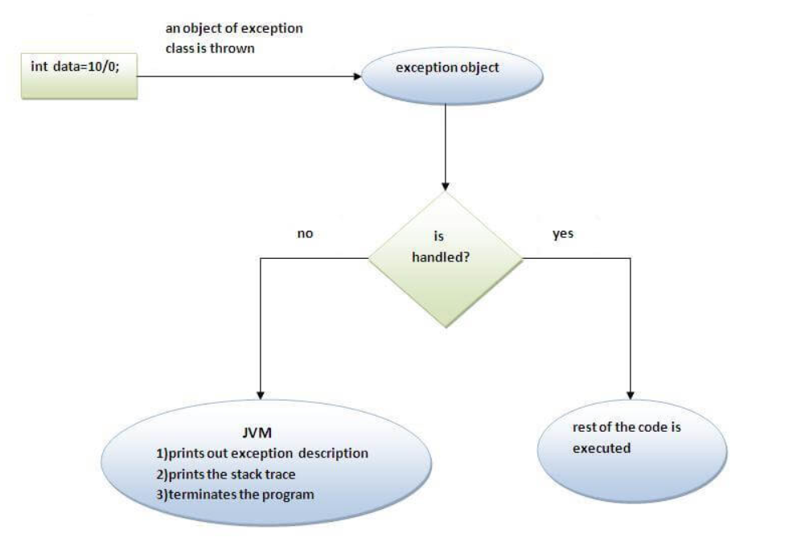
Internal working of java try-catch block

Slide 17
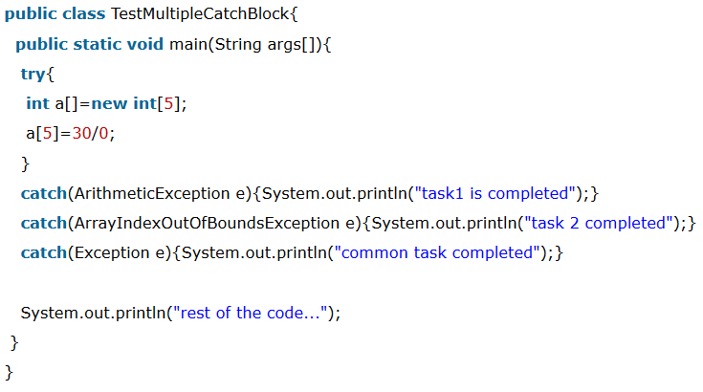
Java multiple catch
If you have to perform different tasks at the occurrence of different Exceptions, use java multi catch block.

Slide 18
Java multiple catch rules
Rule: At a time only one Exception is occured and at a time only one catch block is executed.
Rule: All catch blocks must be ordered from most specific to most general i.e. catch for ArithmeticException must come before catch for Exception

Slide 19
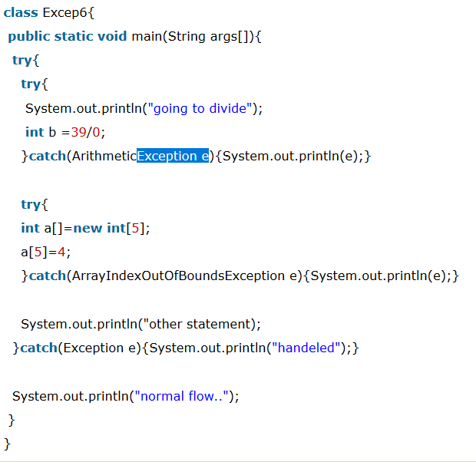
Java nested try/catch blocks

Slide 20
Java finally block
Java finally block is a block that is used to execute important code such as closing connection, stream etc.
Java finally block is always executed whether exception is handled or not.
Java finally block follows try or catch block.
Note: If you don't handle exception, before terminating the program, JVM executes finally block(if any).

Slide 21
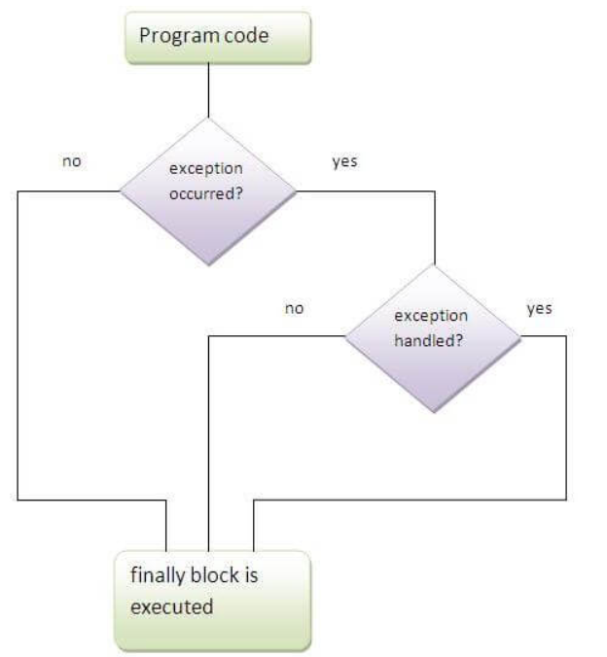
Java finally block

Slide 22
Java finally block rules
Rule: For each try block there can be zero or more catch blocks, but only one finally block.
Note: The finally block will not be executed if program exits(either by calling System.exit() or by causing a fatal error that causes the process to abort).

Slide 23
Java throw exceptions
The Java throw keyword is used to explicitly throw an exception.
We can throw either checked or uncheked exception in java by throw keyword. The throw keyword is mainly used to throw custom exception. We will see custom exceptions later.

Slide 24
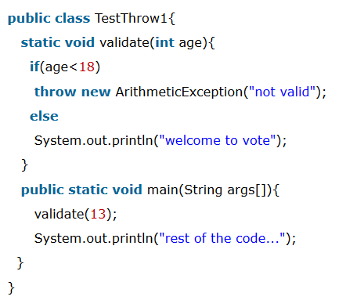
Java throw exceptions
throw exception;

Slide 25
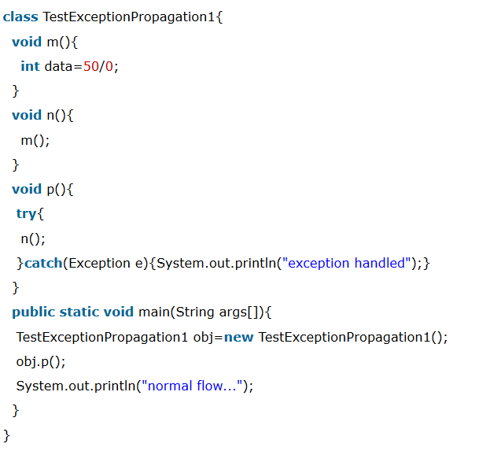
Java exceptions propagations
Rule: By default Unchecked Exceptions are forwarded in calling chain (propagated).

Slide 26
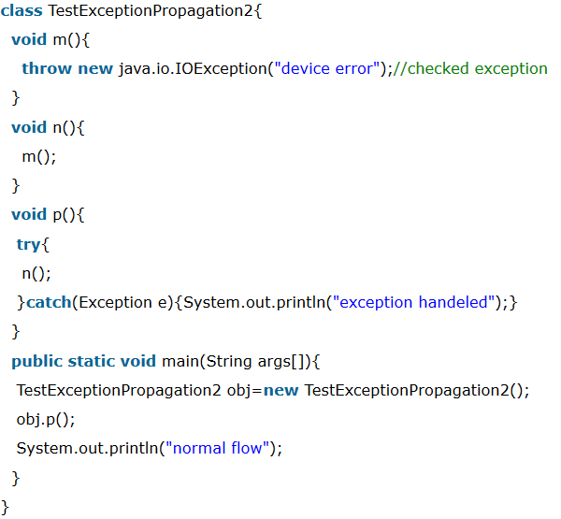
Java exceptions propagations
Rule: By default, Checked Exceptions are not forwarded in calling chain (propagated).

Slide 27
Java throws keyword
The Java throws keyword is used to declare an exception. It gives an information to the programmer that there may occur an exception so it is better for the programmer to provide the exception handling code so that normal flow can be maintained.
Exception Handling is mainly used to handle the checked exceptions. If there occurs any unchecked exception such as NullPointerException, it is programmers fault that he is not performing check up before the code being used.

Slide 28
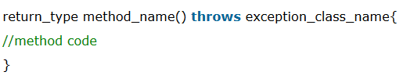
Java throws keyword syntax

Slide 29
Java throws keyword rules
Rule: If you are calling a method that declares an exception, you must either caught or declare the exception.
There are two cases:
Case1:You caught the exception i.e. handle the exception using try/catch.
Case2:You declare the exception i.e. specifying throws with the method.

Slide 30
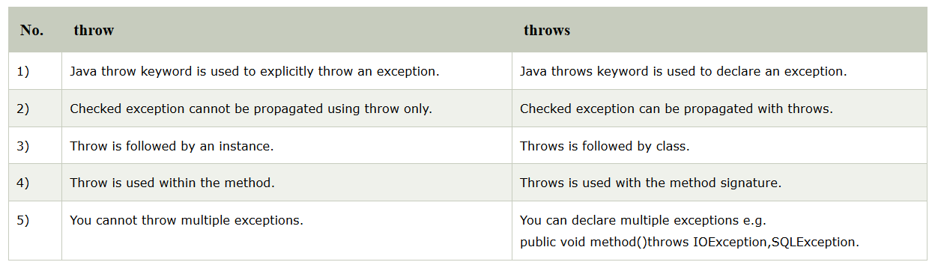
Difference between throw and throws

Slide 31
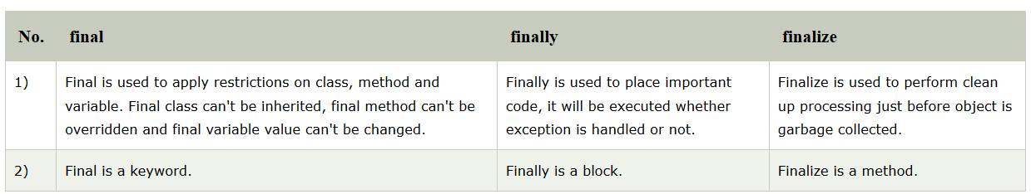
Final, finally, finalize

Slide 32
Exception handling with method overriding
There are many rules if we talk about method overriding with exception handling. The Rules are as follows:
Rule: If the superclass method does not declare an exception, subclass overridden method cannot declare the checked exception.
Rule: If the superclass method does not declare an exception, subclass overridden method cannot declare the checked exception but can declare unchecked exception.
Rule: If the superclass method declares an exception, subclass overridden method can declare same, subclass exception or no exception but cannot declare parent exception.

Slide 33
Custom exceptions
If you are creating your own Exception that is known as custom exception or user-defined exception. Java custom exceptions are used to customize the exception according to user need.
By the help of custom exception, you can have your own exception and message.

Slide 34
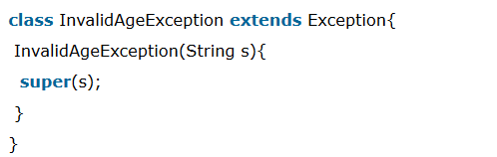
Custom exceptions

Slide 35
Întrebări, sugestii, propuneri

